Slide 1
Data Analytics (CS3203N)
Lecture #3
Descriptive Statistics

Slide 2

Quote of the day..
Change your thoughts and you change your world.
Norman Vincent Peale, American - Clergyman

Slide 3
Just a minute to mark your attendance

Slide 4
Today’s discussion…
Introduction
Data summarization
Measurement of location
Mean, median, mode, midrange, etc.
Measure of dispersion
Range, Variance, Standard Deviation, etc.
Other measures
MAD, AAD, Percentile, IQR, etc.
Graphical summarization
Box plot

Slide 5
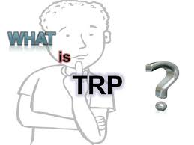
TRP: An example
Television rating point (TRP) is a tool provided
to judge which programs are viewed the most.
This gives us an index of the choice of the people
and also the popularity of a particular channel.
For calculation purpose, a device is attached to the TV sets in few thousand viewers’ houses in different geographic and demographic sectors.
The device is called as People's Meter. It reads the time and the programme that a viewer watches on a particular day for a certain period.
An average is taken, for example, for a 30-days period.
The above further can be augmented with a personal interview survey (PIS), which becomes the basis for many studies/decision making.
Essentially, we are to analyze data for TRP estimation.

Slide 6
Defining Data
A set of data is a collection of observed values representing one or more characteristics of some objects or units.
Definition 3.1: Data
Example: For TRP, data collection consist of the following attributes.
Age: A viewer’s age in years
Sex: A viewer’s gender coded 1 for male and 0 for female
Happy: A viewer’s general happiness
NH for not too happy
PH for pretty happy
VH for very happy
TVHours: The average number of hours a respondent watched TV during a day

Slide 7
Defining Data
Viewer# | Age | Sex | Happy | TVHours
… | … | … | … | …
… | … | … | … | …
55 | 34 | F | VH | 5
… | … | … | … | …
Note:
A data set is composed of information from a set of units.
Information from a unit is known as an observation.
An observation consists of one or more pieces of information about a unit; these are called variables.

Slide 8
Defining Population
A population is a data set representing the entire entities of interest.
Definition 3.2: Population
Example: All TV Viewers in the country/world.
Note:
All people in the country/world is not a population.
For different survey, the population set may be completely different.
For statistical learning, it is important to define the population that we intend to study very carefully.

Slide 9
Defining Sample
A sample is a data set consisting of a population.
Definition 3.3: Sample
Example: All students studying in class is a sample, whereas those students belonging to a given school is population.
Note:
Normally a sample is obtained in such a way as to be representative of the population.

Slide 10

Defining Statistics
A statistics is a quantity calculated from data that describes a particular characteristics of a sample.
Definition 3.4: Statistics
Example: The sample mean (denoted by $\overline{y}$) is the arithmetic mean of a
variable of all the observations of a sample.

Slide 11
Defining Statistical Inference
Statistical inference is the process of using sample statistics to make decisions about population.
Definition 3.5: Statistical inference
Example: In the context of TRP
Overall frequency of the various levels of happiness.
Is there a relationship between the age of a viewers and his/her general happiness?
Is there a relationship between the age of the viewer and the number of TV hours watched?

Slide 12
Data Summarization
To identify the typical characteristics of data (i.e., to have an overall picture).
To identify which data should be treated as noise or outliers.
The data summarization techniques can be classified into two broad categories:
Measures of location
Measures of dispersion

Slide 13
Measurement of location
It is also alternatively called as measuring the central tendency.
A function of the sample values that summarizes the location information into a single number is known as a measure of location.
The most popular measures of location are
Mean
Median
Mode
Midrange
These can be measured in three ways
Distributive measure
Algebraic measure
Holistic measure

Slide 14
Distributive measure
It is a measure (i.e. function) that can be computed for a given data set by partitioning the data into smaller subsets, computing the measure for each subset, and then merging the results in order to arrive at the measure’s value for the original (i.e. entire) data set.
Example
sum(), count()

Slide 15
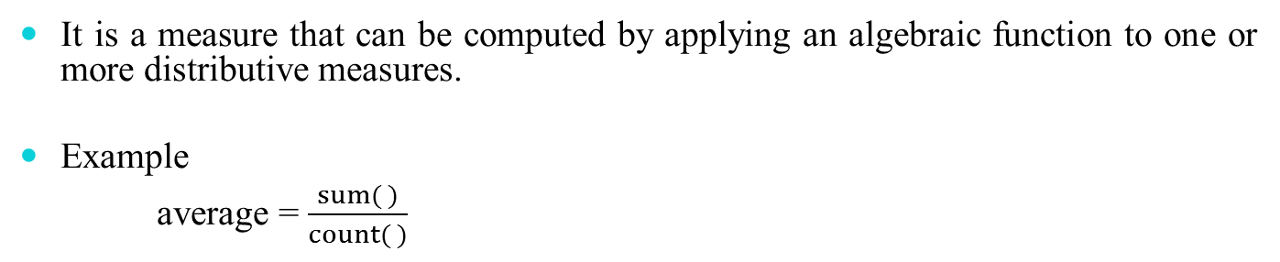
Algebraic measure
It is a measure that can be computed by applying an algebraic function to one or more distributive measures.
Example
average = $\frac{sum( )}{count( )}$

Slide 16
Holistic measure
It is a measure that must be computed on the entire data set as a whole.
Example
Calculating median
What about mode?

Slide 17
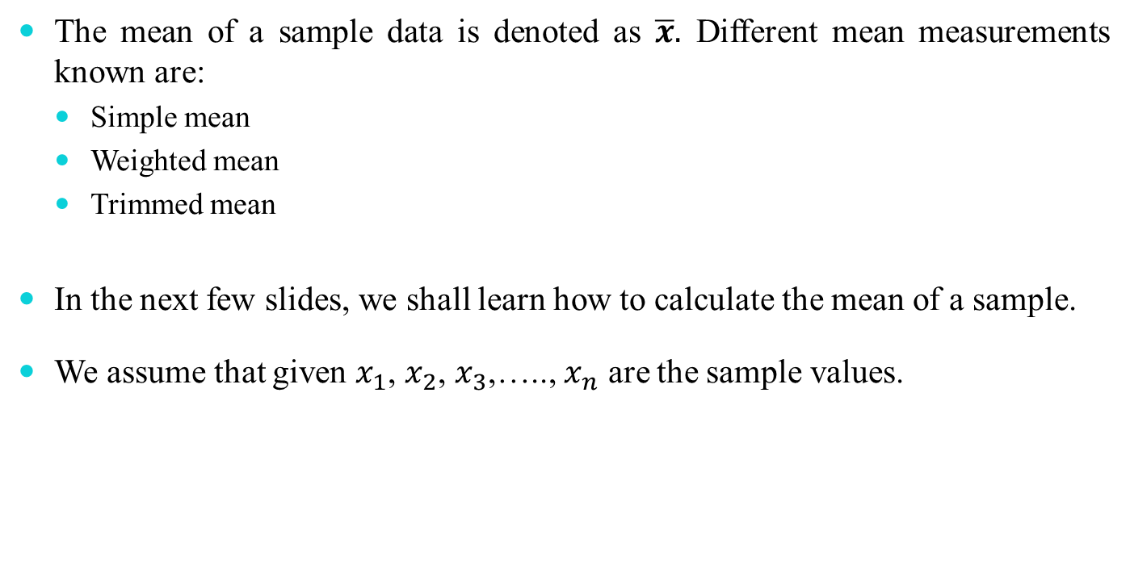
Mean of a sample
The mean of a sample data is denoted as $\overline{x}.$ Different mean measurements known are:
Simple mean
Weighted mean
Trimmed mean
In the next few slides, we shall learn how to calculate the mean of a sample.
We assume that given $x_{1}$, $x_{2}$, $x_{3}$,….., $x_{n}$ are the sample values.

Slide 18
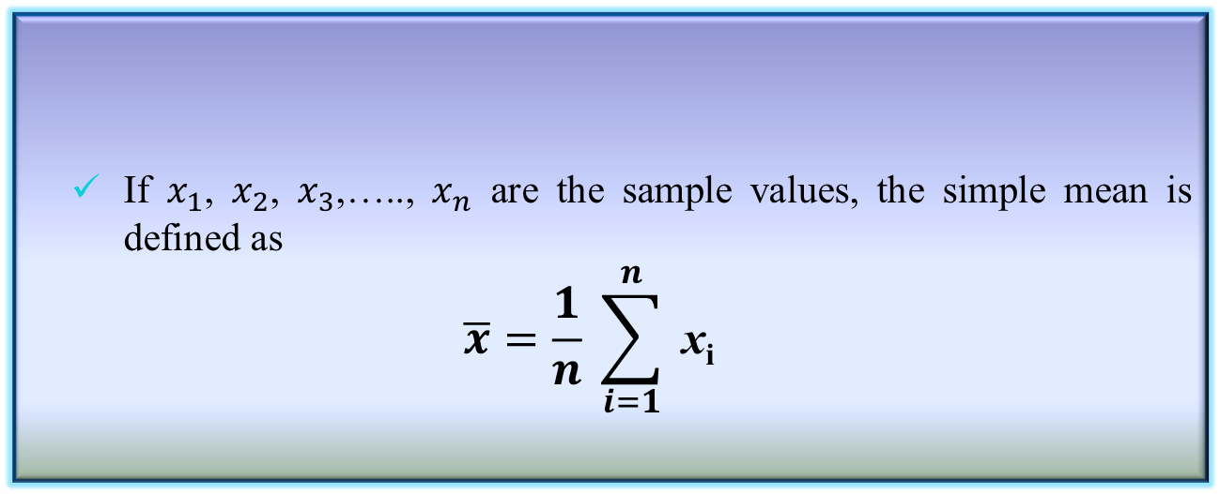
Simple mean of a sample
Simple mean
It is also called simply arithmetic mean or average and is abbreviated as (AM).
If $x_{1}$, $x_{2}$, $x_{3}$,….., $x_{n}$ are the sample values, the simple mean is defined as
$$\overline{x}=\frac{1}{n} \sum_{i=1}^{n}{ \text{x}\text{i}}$$
Definition 3.6: Simple mean

Slide 19
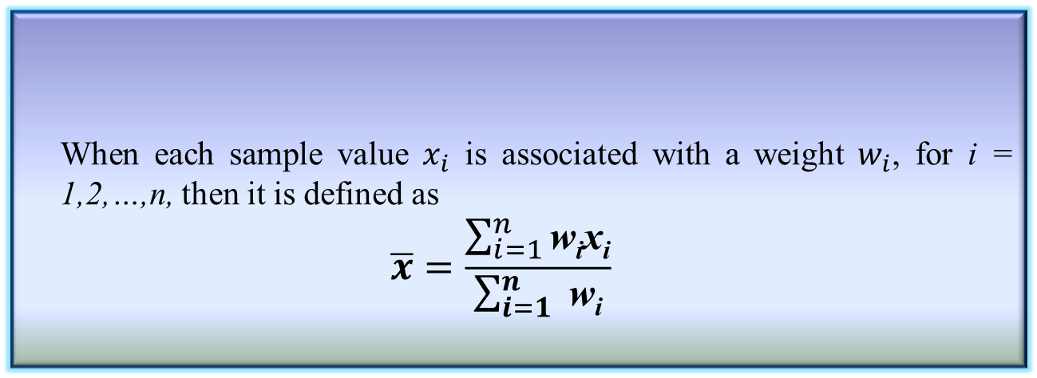
Weighted mean of a sample
Weighted mean
It is also called weighted arithmetic mean or weighted average.
When each sample value $x_{i}$ is associated with a weight $w_{i}$, for i = 1,2,…,n, then it is defined as
$$\overline{x}=\frac{\sum_{i=1}^{n}{\text{w}\text{i}\text{x}\text{i}}}{\sum_{i=1}^{n}{ \text{w}\text{i}}}$$
Definition 3.7: Weighted mean
Note
When all weights are equal, the weighted mean reduces to simple mean.

Slide 20
Trimmed mean of a sample
Trimmed Mean
If there are extreme values (also called outlier) in a sample, then the mean is influenced greatly by those values. To offset the effect caused by those extreme values, we can use the concept of trimmed mean
Trimmed mean is defined as the mean obtained after chopping off values at the high and low extremes.
Definition 3.8: Trimmed mean

Slide 21
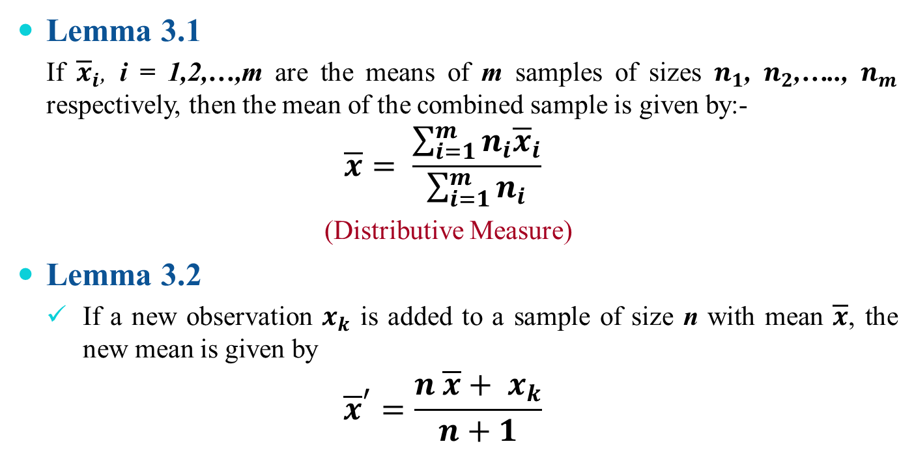
Properties of mean
Lemma 3.1
If ${\overline{x}}_{i}$, i = 1,2,…,m are the means of m samples of sizes $n_{1}$, $n_{2}$,….., $n_{m}$ respectively, then the mean of the combined sample is given by:-
$$\overline{x}= \frac{\sum_{i=1}^{m}{n_{i}{\overline{x}}_{i}}}{\sum_{i=1}^{m}{n_{i}}}$$
(Distributive Measure)
Lemma 3.2
If a new observation $x_{k}$ is added to a sample of size n with mean $\overline{x}$, the new mean is given by
$${\overline{x}}^{′}=\frac{n \overline{x}+ x_{k}}{n+1}$$

Slide 22
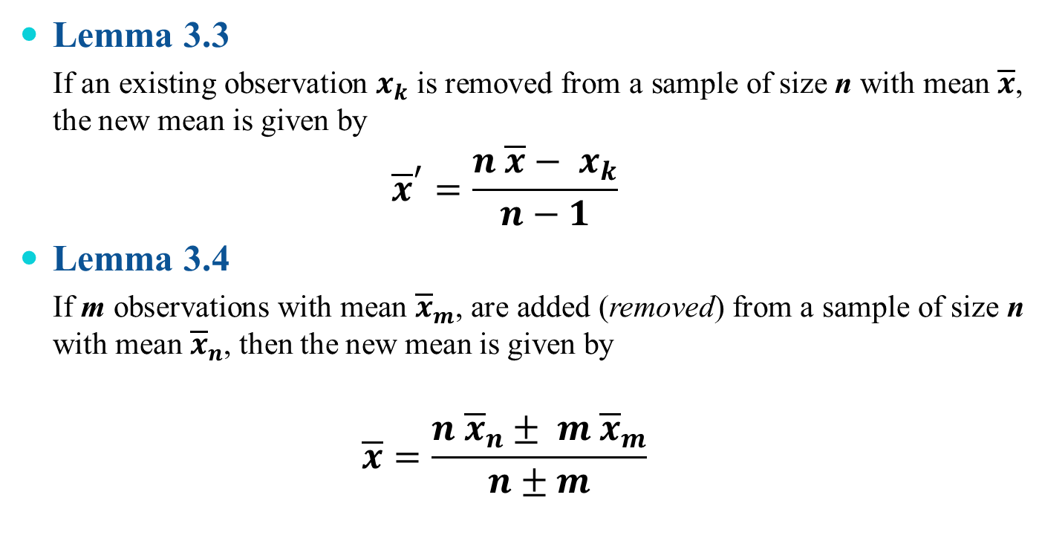
Properties of mean
Lemma 3.3
If an existing observation $x_{k}$ is removed from a sample of size n with mean $\overline{x}$, the new mean is given by
$${\overline{x}}^{′}=\frac{n \overline{x}− x_{k}}{n−1}$$
Lemma 3.4
If m observations with mean ${\overline{x}}_{m}$, are added (removed) from a sample of size n with mean ${\overline{x}}_{n}$, then the new mean is given by
$$\overline{x}=\frac{n {\overline{x}}_{n}± m {\overline{x}}_{m}}{n±m}$$

Slide 23
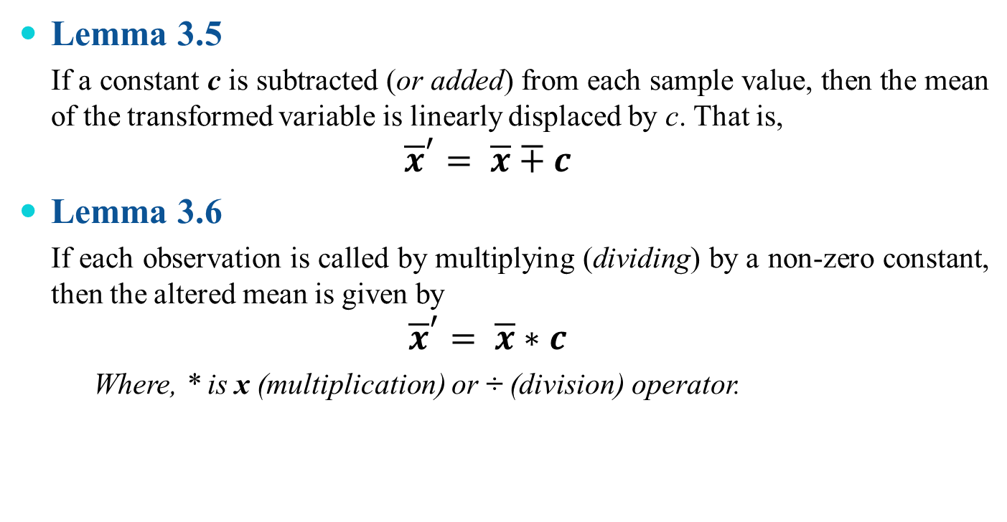
Properties of mean
Lemma 3.5
If a constant c is subtracted (or added) from each sample value, then the mean of the transformed variable is linearly displaced by c. That is,
$${\overline{x}}^{′}= \overline{x}∓c$$
Lemma 3.6
If each observation is called by multiplying (dividing) by a non-zero constant, then the altered mean is given by
$${\overline{x}}^{′}= \overline{x}∗c$$
Where, * is x (multiplication) or ÷ (division) operator.

Slide 24
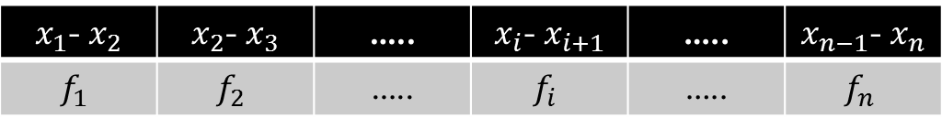
Mean with grouped data
Sometimes data is given in the form of classes and frequency for each class.
Class →
Frequency →
$x_{1}$- $x_{2}$ | $x_{2}$- $x_{3}$ | ….. | $x_{i}$- $x_{i+1}$ | ….. | $x_{n−1}$- $x_{n}$
$$f_{1}$$ | $$f_{2}$$ | ….. | $$f_{i}$$ | ….. | $$f_{n}$$
There three methods to calculate the mean of such a grouped data.
Direct method
Assumed mean method
Step deviation method

Slide 25
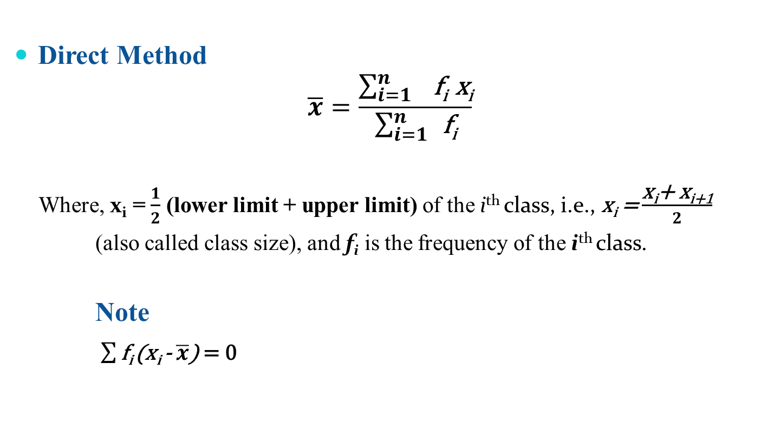
Direct method
Direct Method
$$\overline{x}=\frac{\sum_{i=1 }^{n}{\text{f}\text{i} \text{x}\text{i}}}{\sum_{i=1}^{n}{ }\text{f}\text{i}}$$
Where, $\text{x}\text{i}$ = $\frac{1}{2}$ (lower limit + upper limit) of the i^{th} class, i.e., $\text{x}\text{i}$ = $\frac{\text{x}\text{i}\text{+ }\text{x}\text{i}\text{+1}}{2}$
(also called class size), and $\text{f}\text{i}$ is the frequency of the i^{th} class.
Note
$\sum{\text{f}\text{i} }$($\text{x}\text{i}$ - $\overline{x}$) = 0

Slide 26
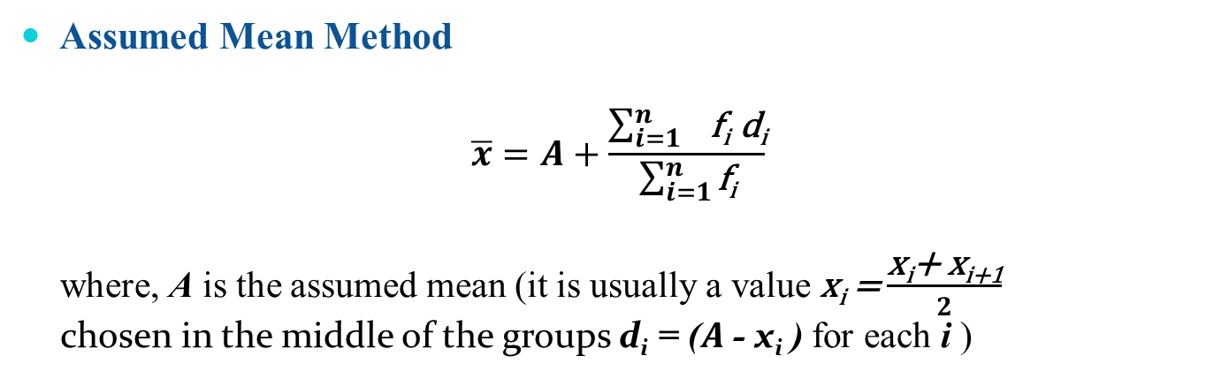
Assumed mean method
Assumed Mean Method
$$\overline{x}=A+\frac{\sum_{i=1 }^{n}{\text{f}\text{i} \text{d}\text{i}}}{\sum_{i=1}^{n}{\text{f}\text{i}}}$$
where, A is the assumed mean (it is usually a value $\text{x}\text{i}$ = $\frac{\text{x}\text{i}\text{+ }\text{x}\text{i}\text{+1}}{2}$
chosen in the middle of the groups $\text{d}\text{i}$ = ($A$- $\text{x}\text{i}$ ) for each i )

Slide 27
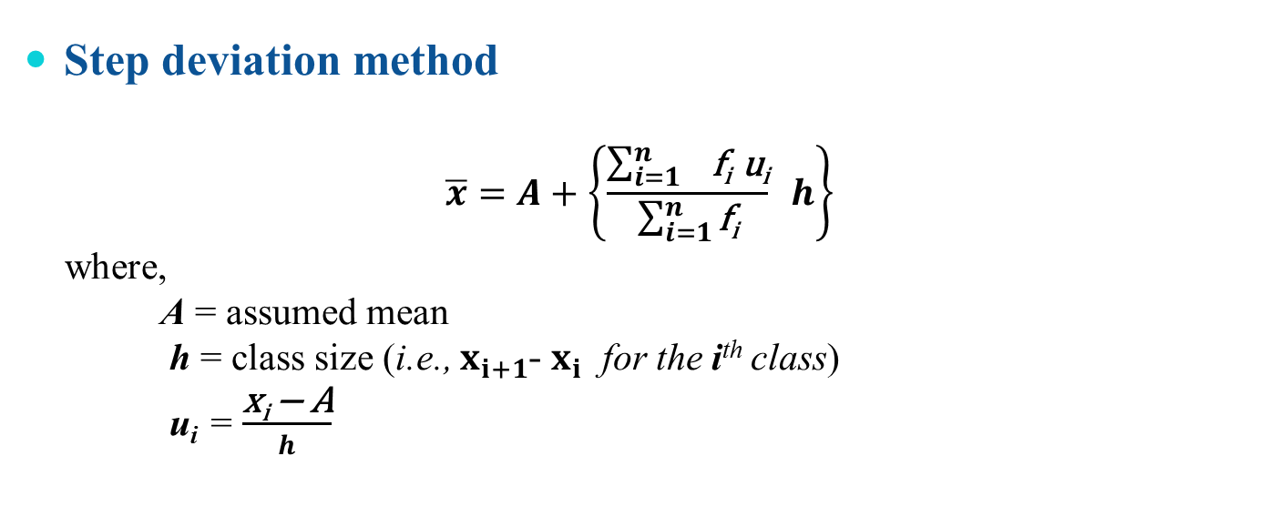
Step deviation method
Step deviation method
$$\overline{x}=A+\left\{\frac{\sum_{i=1 }^{n}{\text{f}\text{i} \text{u}\text{i}}}{\sum_{i=1}^{n}{\text{f}\text{i}}} h\right\}$$
where,
A = assumed mean
h = class size (i.e., $x_{i+1}$- $x_{i}$ for the i^{th} class)
u_{i} = $\frac{\text{x}\text{i} \text{−} \text{A}}{h}$

Slide 28
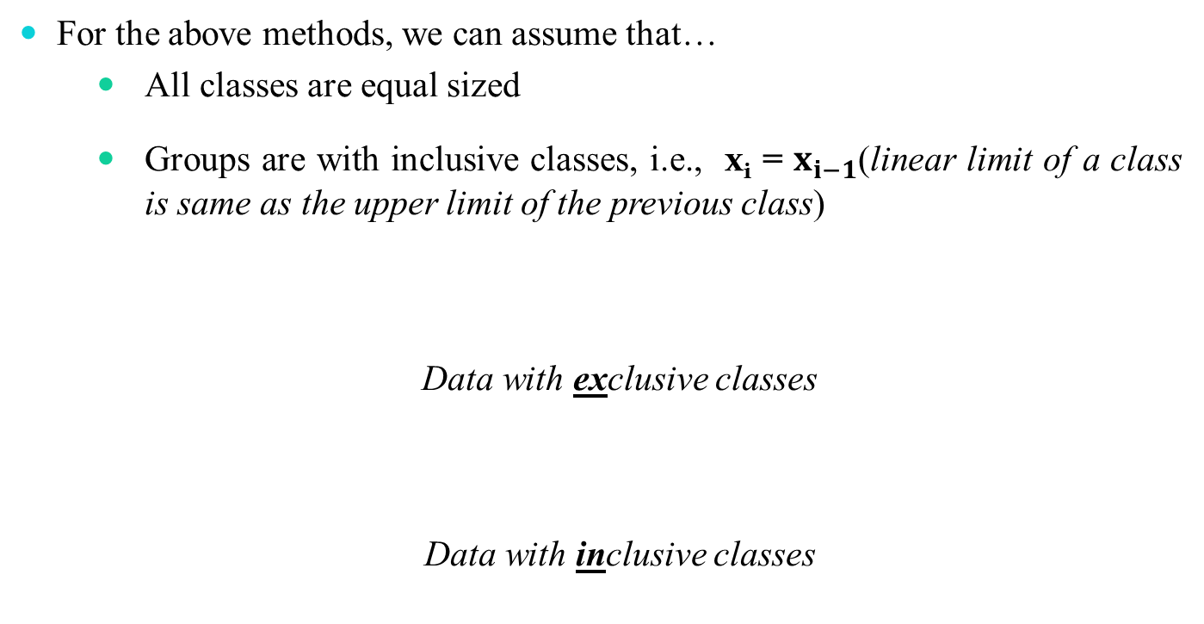
Mean for a group of data
For the above methods, we can assume that…
All classes are equal sized
Groups are with inclusive classes, i.e., $\text{x}\text{i}$ = $x_{i−1}$(linear limit of a class is same as the upper limit of the previous class)
Data with exclusive classes
Data with inclusive classes
10 - 19 | 20 - 29 | 30 - 39 | $$\text{4}\text{0 − }\text{4}\text{9}$$
9.5 – 19.5 | 19.5 – 29.5 | 29.5 – 39.5 | $$\text{39}\text{.5 – }\text{4}\text{9.5}$$

Slide 29
Ogive: Graphical method to find mean
Ogive (pronounced as O-Jive) is a cumulative frequency polygon graph.
When cumulative frequencies are plotted against the upper (lower) class limit, the plot resembles one side of an Arabesque or ogival architecture, hence the name.
There are two types of Ogive plots
Less-than (upper class vs. cumulative frequency)
More than (lower class vs. cumulative frequency)
Example:
Suppose, there is a data relating the marks obtained by 200 students in an examination
444, 412, 478, 467, 432, 450, 410, 465, 435, 454, 479, …….
(Further, suppose it is observed that the minimum and maximum marks are 410, 479, respectively.)

Slide 30
Ogive: Cumulative frequency table
444, 412, 478, 467, 432, 450, 410, 465, 435, 454, 479, …….
Step 1: Draw a cumulative frequency table
Marks | Conversion into exclusive series | No. of students | Cumulative Frequency
(x) |  | (f) | (C.M)
410-419 | 409.5-419.5 | 14 | 14
420-429 | 419.5-429.5 | 20 | 34
430-439 | 429.5-439.5 | 42 | 76
440-449 | 439.5-449.5 | 54 | 130
450-459 | 449.5-459.5 | 45 | 175
460-469 | 459.5-469.5 | 18 | 193
470-479 | 469.5-479.5 | 7 | 200

Slide 31
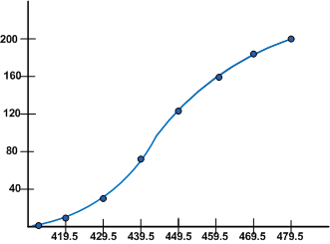
Ogive: Graphical method to find mean
Marks | Conversion into exclusive series | No. of students | Cumulative Frequency
(x) |  | (f) | (C.M)
410-419 | 409.5-419.5 | 14 | 14
420-429 | 419.5-429.5 | 20 | 34
430-439 | 429.5-439.5 | 42 | 76
440-449 | 439.5-449.5 | 54 | 130
450-459 | 449.5-459.5 | 45 | 175
460-469 | 459.5-469.5 | 18 | 193
470-479 | 469.5-479.5 | 7 | 200
Step 2: Less-than Ogive graph
Upper class | Cumulative Frequency
Less than 419.5 | 14
Less than 429.5 | 34
Less than 439.5 | 76
Less than 449.5 | 130
Less than 459.5 | 175
Less than 469.5 | 193
Less than 479.5 | 200

Slide 32
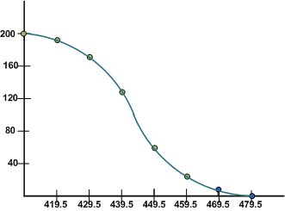
Ogive: Graphical method to find mean
Marks | Conversion into exclusive series | No. of students | Cumulative Frequency
(x) |  | (f) | (C.M)
410-419 | 409.5-419.5 | 14 | 14
420-429 | 419.5-429.5 | 20 | 34
430-439 | 429.5-439.5 | 42 | 76
440-449 | 439.5-449.5 | 54 | 130
450-459 | 449.5-459.5 | 45 | 175
460-469 | 459.5-469.5 | 18 | 193
470-479 | 469.5-479.5 | 7 | 200
Step 3: More-than Ogive graph
Upper class | Cumulative Frequency
More than 409.5 | 200
More than 419.5 | 186
More than 429.5 | 166
More than 439.5 | 124
More than 449.5 | 70
More than 459.5 | 25
More than 469.5 | 7

Slide 33
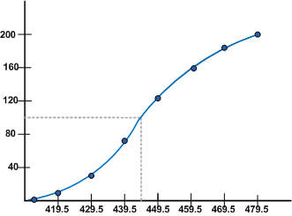

Information from Ogive
Mean from Less-than Ogive
Mean from More-than Ogive
A % C freq of .65 for the third class 439.5.....449.5 means that 65% of all scores are found in this class or below.

Slide 34
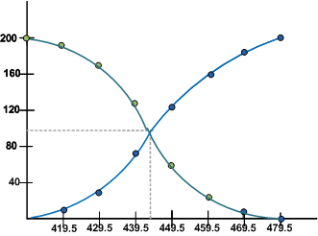
Information from Ogive
Less-than and more-than Ogive approach
A cross point of two Ogive plots gives the mean of the sample

Slide 35
Some other measures of mean
There are three mean measures of location:
Arithmetic Mean (AM)
Geometric mean (GM)
Harmonic mean (HM)

Slide 36

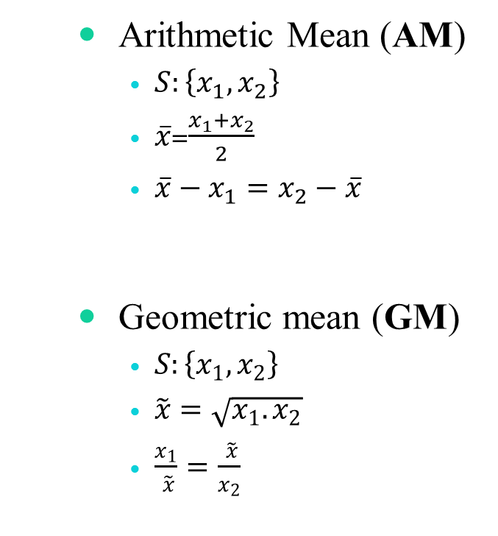
Some other measures of mean
Arithmetic Mean (AM)
$S:\left\{x_{1},x_{2}\right\}$
$\overline{x}$=$\frac{x_{1}+x_{2}}{2}$
$\overline{x}−x_{1}=x_{2}−\overline{x}$
Geometric mean (GM)
$S:\left\{x_{1},x_{2}\right\}$
$\tilde{x}=\sqrt{x_{1}.x_{2}}$
$\frac{x_{1}}{ \tilde{x}}=\frac{ \tilde{x}}{x_{2}}$
Harmonic Mean (HM)
$S:\left\{x_{1},x_{2}\right\}$
$\hat{x}=\frac{2}{\frac{1}{x_{1}}+ \frac{1}{x_{2}}}$
$\frac{2}{\hat{x}}=\frac{1}{x_{1}}+\frac{1}{x_{2}}$

Slide 37
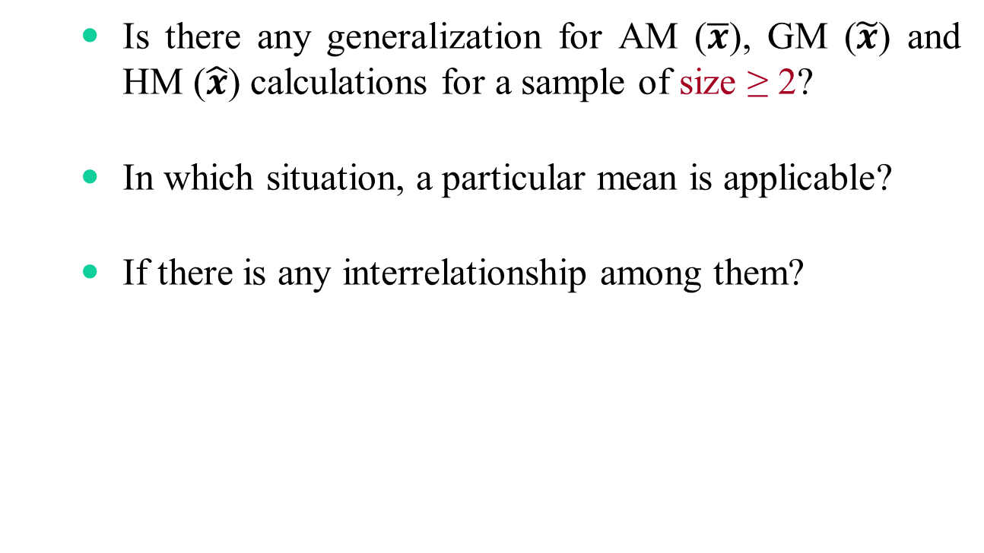
???
Is there any generalization for AM ($\overline{x}$), GM ($\tilde{x}$) and HM ($\hat{x}$) calculations for a sample of size ≥ 2?
In which situation, a particular mean is applicable?
If there is any interrelationship among them?

Slide 38
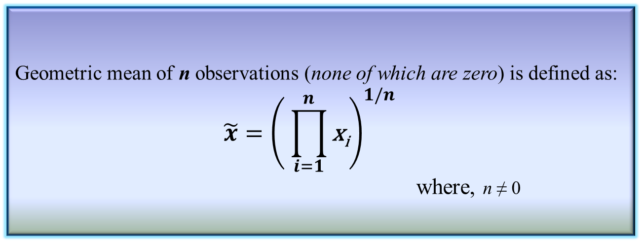
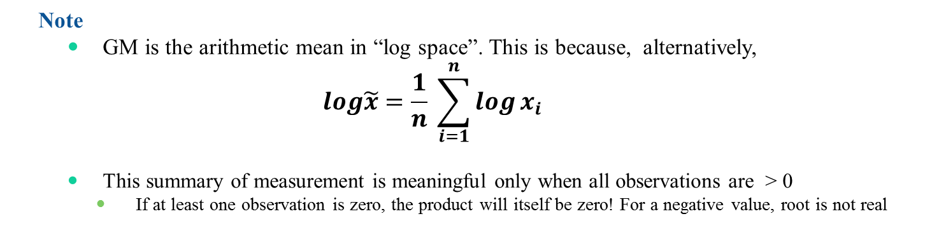
Geometric mean
Geometric mean of n observations (none of which are zero) is defined as:
$$\tilde{x}={\left( \prod_{i=1}^{n}{\text{x}\text{i}}\right)}^{1/n}$$
where, n ≠ 0
Definition 3.9: Geometric mean
Note
GM is the arithmetic mean in “log space”. This is because, alternatively,
$$log\tilde{x}=\frac{1}{n} \sum_{i=1}^{n}{\log{x_{i}} }$$
This summary of measurement is meaningful only when all observations are > 0
If at least one observation is zero, the product will itself be zero! For a negative value, root is not real

Slide 39
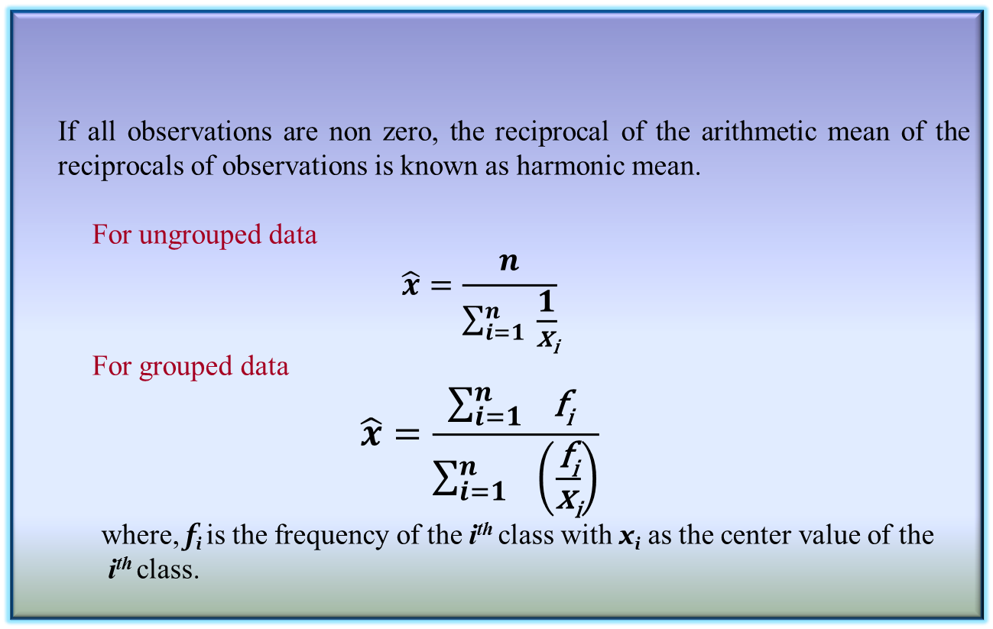
Harmonic mean
If all observations are non zero, the reciprocal of the arithmetic mean of the reciprocals of observations is known as harmonic mean.
For ungrouped data
$$\hat{x}=\frac{n}{\sum_{i=1}^{n}{ \frac{1}{\text{x}\text{i}}}}$$
For grouped data
$$\hat{x}=\frac{\sum_{i=1 }^{n}{\text{f}\text{i} }}{\sum_{i=1}^{n}{ }\left(\frac{\text{f}\text{i}}{\text{x}\text{i}}\right)}$$
where, $\text{f}\text{i}$is the frequency of the i^{th} class with $\text{x}\text{i}$ as the center value of the
i^{th} class.
Definition 3.10: Harmonic mean

Slide 40
Significant of different mean calculations
There are two things involved when we consider a sample
Observation
Range
Example: Rainfall data
Here, rainfall is the observation and day is the range for each element in the sample
Here, we are to measure the mean “rate of rainfall” as the measure of location
Rainfall (in mm) | r₁ | r₂ | … | r_{n}
Days (in number) | d₁ | d₂ | … | d_{n}

Slide 41
Significant of different mean calculations
Case 1: Range remains same for each observation
Example: Having data about amount of rainfall per week, say.
Rainfall (in mm) | 35 | 18 | … | 22
Days (in number) | 7 | 7 | … | 7

Slide 42
Significant of different mean calculations
Case 2: Ranges are different, but observation remains same
Example: Same amount of rainfall in different number of days, say.
Rainfall (in mm) | 50 | 50 | … | 50
Days (in number) | 1 | 2 | … | 7

Slide 43
Significant of different mean calculations
Case 3: Ranges are different, as well as the observations
Example: Different amount of rainfall in different number of days, say.
Rainfall (in mm) | 21 | 34 | … | 18
Days (in number) | 5 | 3 | … | 7

Slide 44

Rule of thumbs for means
AM: When the range remains same for each observation
Example: Case 1
Rainfall (in mm) | 35 | 18 | … | 22
Days (in number) | 7 | 7 | … | 7
$$\overline{r}=\frac{1}{n}\sum_{1}^{n}{r_{i}}$$

Slide 45

Rule of thumbs for means
HM: When the range is different but each observation is same
Example: Case 2
Rainfall (in mm) | 50 | 50 | … | 50
Days (in number) | 1 | 2 | … | 7
$$\tilde{r}=\frac{n}{\sum_{1}^{n}{\frac{1}{r_{i}}}}$$

Slide 46

Rule of thumbs for means
GM: When the ranges are different as well as the observations
Example: Case 3
Rainfall (in mm) | 21 | 34 | … | 18
Days (in number) | 5 | 3 | … | 7
$$\hat{r}={\left(\prod_{1}^{n}{r_{i}}\right)}^{\frac{1}{n}}$$

Slide 47
Rule of thumbs for means
The important things to recognize is that all three means are simply the arithmetic means in disguise!
Each mean follows the “additive structure”.
Suppose, we are given some abstract quantities {x₁, x₂, …, x_{n}}
Each of the three means can be obtained with the following steps
Transform each x_{i} into some y_{i}
Taking the arithmetic mean of all y_{i}’s
Transforming back the to the original scale of measurement

Slide 48
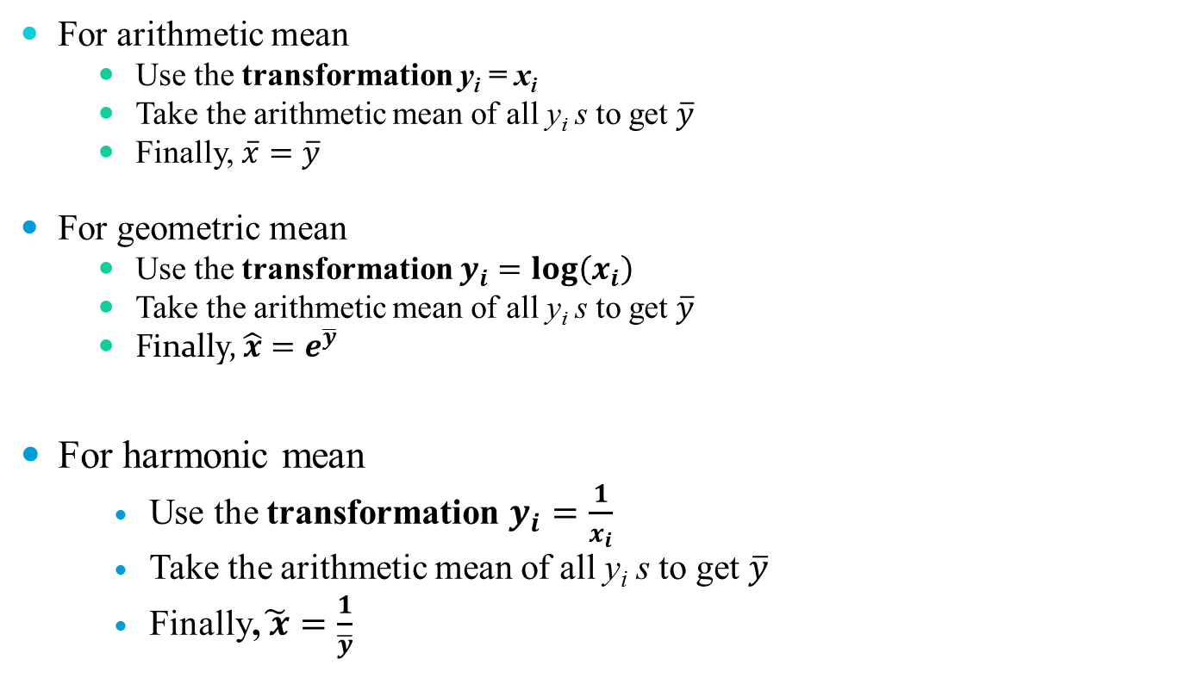
Rule of thumbs for means
For arithmetic mean
Use the transformation y_{i} = x_{i}
Take the arithmetic mean of all y_{i} s to get $\overline{y}$
Finally, $\overline{x}=\overline{y}$
For geometric mean
Use the transformation $y_{i}=log\left(x_{i}\right)$
Take the arithmetic mean of all y_{i} s to get $\overline{y}$
Finally, $\hat{x}=e^{\overline{y}}$
For harmonic mean
Use the transformation $y_{i}=\frac{1}{x_{i}}$
Take the arithmetic mean of all y_{i} s to get $\overline{y}$
Finally,$\tilde{ x}=\frac{1}{\overline{y}}$

Slide 49
Relationship among means
A simple inequality exists between the three means related summary measure as
AM ≥ GM ≥ HM

Slide 50
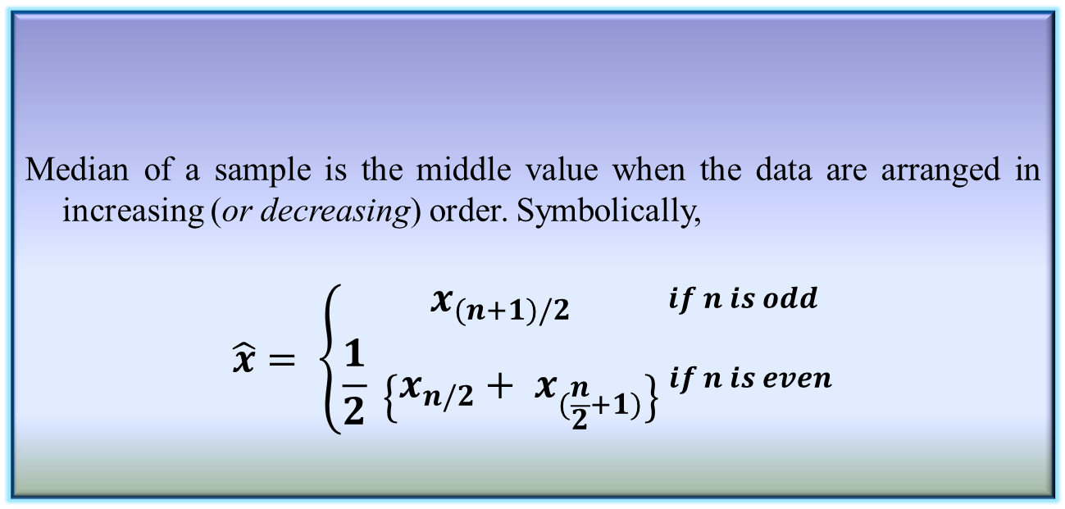
Median of a sample
Median of a sample is the middle value when the data are arranged in increasing (or decreasing) order. Symbolically,
$$\hat{x}= \left\{\begin{aligned}x_{(n+1)/2} \\ \frac{1}{2} \left\{x_{n/2}+ x_{(\frac{n}{2}+1)}\right\}\end{aligned}\right. _{if n is even}^{\begin{aligned}if n is odd \\ \\ \end{aligned}}$$
Definition 3.12: Median of a sample

Slide 51
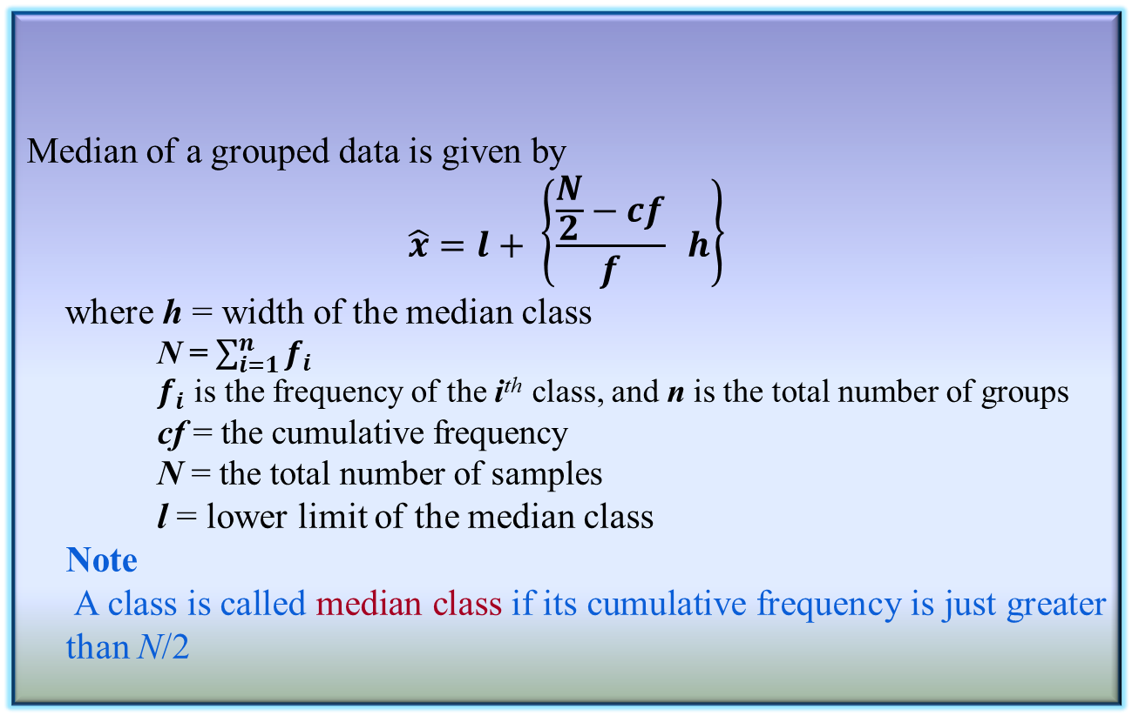
Median of a sample
Median of a grouped data is given by
$$\hat{x}=l+ \left\{\frac{\frac{N}{2}−cf}{f} h\right\}$$
where h = width of the median class
N = $\sum_{i=1}^{n}{f_{i}}$
$f_{i}$ is the frequency of the i^{th} class, and n is the total number of groups
cf = the cumulative frequency
N = the total number of samples
l = lower limit of the median class
Note
A class is called median class if its cumulative frequency is just greater than N/2
Definition 3.12: Median of a grouped data

Slide 52
Mode of a sample
Mode is defined as the observation which occurs most frequently.
For example, number of wickets obtained by bowler in 10 test matches are as follows.
1 2 0 3 2 4 1 1 2 2
In other words, the above data can be represented as:-
Clearly, the mode here is “2”.
 | 0 | 1 | 2 | 3 | 4
# of matches | 1 | 3 | 4 | 1 | 1

Slide 53
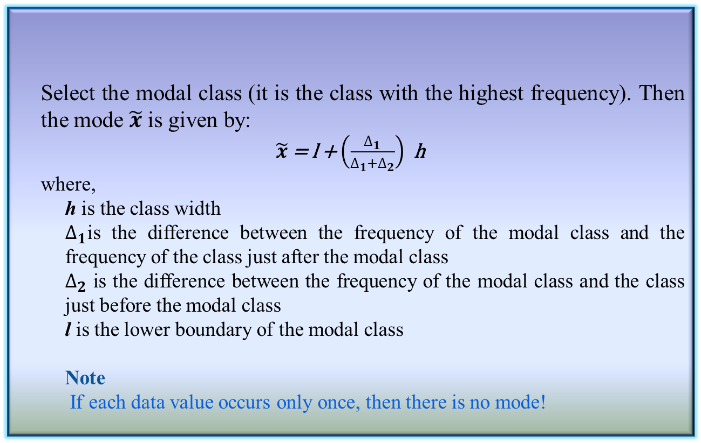
Mode of a grouped data
Select the modal class (it is the class with the highest frequency). Then the mode $\tilde{x}$ is given by:
$\tilde{x}$ = l + $\left(\frac{∆_{1}}{∆_{1}+∆_{2}}\right)$ h
where,
h is the class width
$∆_{1}$is the difference between the frequency of the modal class and the frequency of the class just after the modal class
$∆_{2}$ is the difference between the frequency of the modal class and the class just before the modal class
l is the lower boundary of the modal class
Note
If each data value occurs only once, then there is no mode!
Definition 3.13: Mode of a grouped data

Slide 54
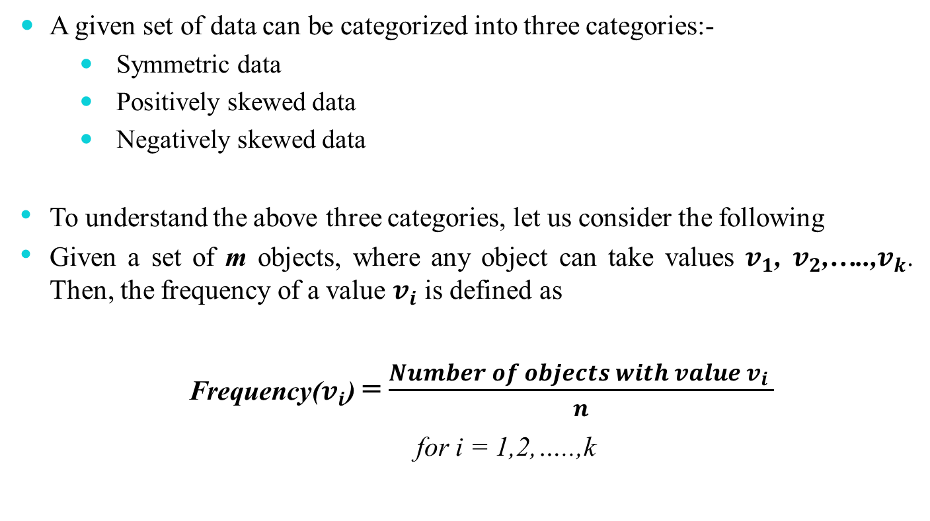
Relation between mean, median and mode
A given set of data can be categorized into three categories:-
Symmetric data
Positively skewed data
Negatively skewed data
To understand the above three categories, let us consider the following
Given a set of m objects, where any object can take values $v_{1}$, $v_{2}$,…..,$v_{k}$. Then, the frequency of a value $v_{i}$ is defined as
Frequency($v_{i}$) = $\frac{Number of objects with value{ v}_{i} }{n}$
for i = 1,2,…..,k

Slide 55
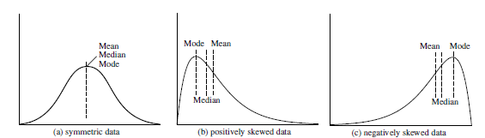
Symmetric data
For symmetric data, all mean, median and mode lie at the same point

Slide 56
Positively skewed data
Here, mode occurs at a value smaller than the median

Slide 57
Negatively skewed data
Here, mode occurs at a value greater than the median

Slide 58
Empirical Relation!
There is an empirical relation, valid for moderately skewed data
Mean – Mode = 3 * (Mean – Median)

Slide 59
Midrange
It is the average of the largest and smallest values in the set.
Steps
A percentage ‘p’ between 0 and 100 is specified.
The top and bottom of (p/2)% of the data is thrown out
The mean is then calculated in the normal way
Thus, the median is trimmed mean with p = 100% while the traditional mean corresponds to p = 0%
Note
Trimmed mean is a special case of Midrange

Slide 60
Measures of dispersion
Location measure are far too insufficient to understand data.
Another set of commonly used summary statistics for continuous data are those that measure the dispersion.
A dispersion measures the extent of spread of observations in a sample.
Some important measure of dispersion are:
Range
Variance and Standard Deviation
Mean Absolute Deviation (MAD)
Absolute Average Deviation (AAD)
Interquartile Range (IQR)

Slide 61
Measures of dispersion
Example
Suppose, two samples of fruit juice bottles from two companies A and B. The unit in each bottle is measured in litre.
Both samples have same mean. However, the bottles from company A with more uniform content than company B.
We say that the dispersion (or variability) of the observation from the average is less for A than sample B.
The variability in a sample should display how the observation spread out from the average
In buying juice, customer should feel more confident to buy it from A than B
Sample A | 0.97 | 1.00 | 0.94 | 1.03 | 1.06
Sample B | 1.06 | 1.01 | 0.88 | 0.91 | 1.14

Slide 62
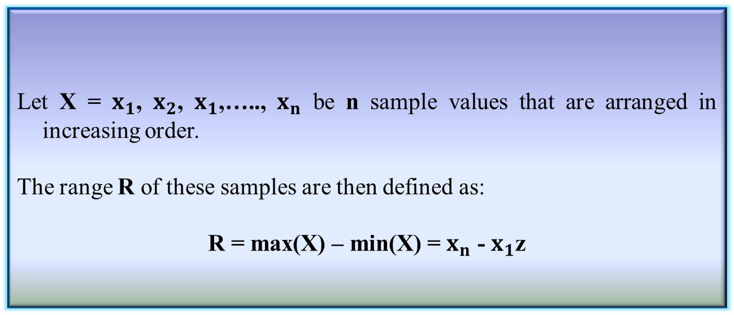
Range of a sample
Definition 3.14: Range of a sample
Let X = $x_{1}$, $x_{2}$, $x_{1}$,….., $x_{n}$ be n sample values that are arranged in increasing order.
The range R of these samples are then defined as:
R = max(X) – min(X) = $x_{n}$ - $x_{1}$z
Range identifies the maximum spread, it can be misleading if most of the values are concentrated in a narrow band of values, but there are also a relatively small number of more extreme values.
The variance is another measure of dispersion to deal with such a situation.

Slide 63
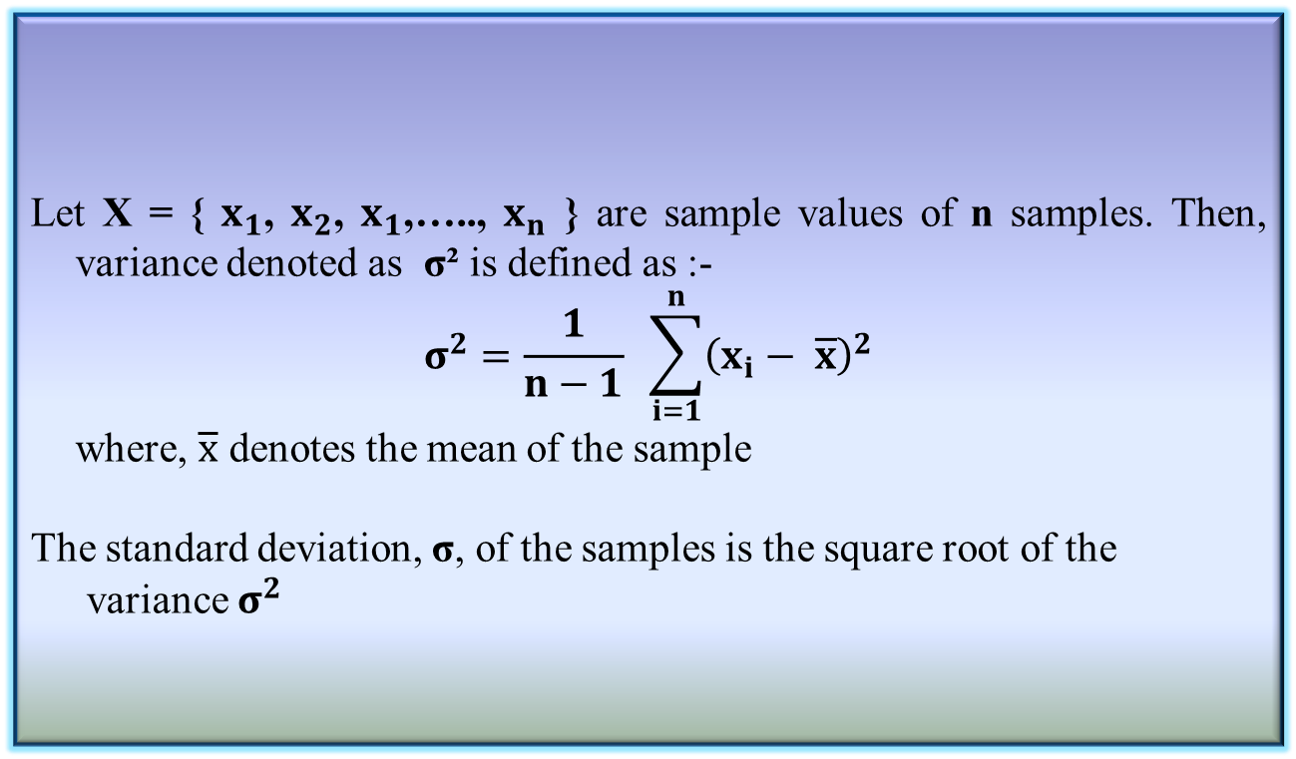
Variance and Standard Deviation
Let X = { $x_{1}$, $x_{2}$, $x_{1}$,….., $x_{n}$ } are sample values of n samples. Then, variance denoted as σ² is defined as :-
$$σ^{2}=\frac{1}{n−1} \sum_{i=1}^{n}{{\left(x_{i}− \overline{x}\right)}^{2}}$$
where, $\overline{x}$ denotes the mean of the sample
The standard deviation, σ, of the samples is the square root of the variance $σ^{2}$
Definition 3.15: Variance and Standard Deviation

Slide 64
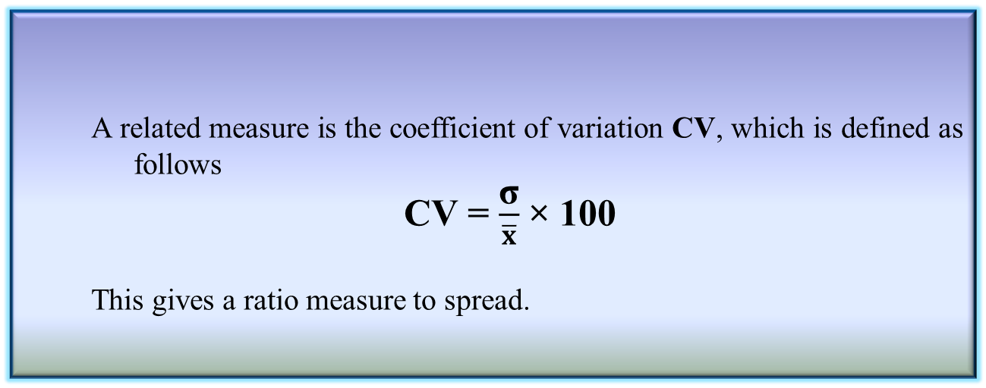
Coefficient variation
Basic properties
σ measures spread about mean and should be chosen only when the mean is chosen as the measure of central tendency
σ = 0 only when there is no spread, that is, when all observations have the same value, otherwise σ > 0
A related measure is the coefficient of variation CV, which is defined as follows
CV = $\frac{\text{σ}}{\overline{x}}$ × 100
This gives a ratio measure to spread.
Definition 3.16: Coefficient variation

Slide 65
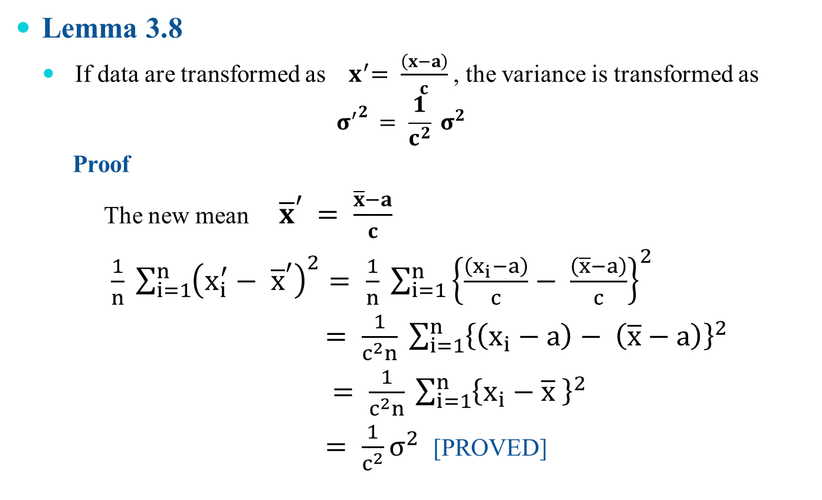
Variance and Standard Deviation
Lemma 3.8
If data are transformed as ${ x}^{′}= \frac{\left(x−a\right)}{c}$ , the variance is transformed as
$${σ^{′}}^{2 }= \frac{1}{c^{2}} σ^{2}$$
Proof
The new mean ${\overline{x}}^{′ }= \frac{\overline{x}−a}{c}$
$\frac{1}{n} \sum_{i=1}^{n}{{\left(x_{i}^{′}− {\overline{x}}^{′}\right)}^{2}= \frac{1}{n}} \sum_{i=1}^{n}{{\left\{\frac{\left(x_{i}−a\right)}{c}− \frac{\left(\overline{x}−a\right)}{c}\right\}}^{2}}$
$= \frac{1}{c^{2}n} \sum_{i=1}^{n}{{\left\{\left(x_{i}−a\right)− \left(\overline{x}−a\right)\right\}}^{2}}$
$= \frac{1}{c^{2}n} \sum_{i=1}^{n}{{\left\{x_{i}−\overline{x} \right\}}^{2}}$
$= \frac{1}{c^{2}}σ^{2}$ [PROVED]

Slide 66
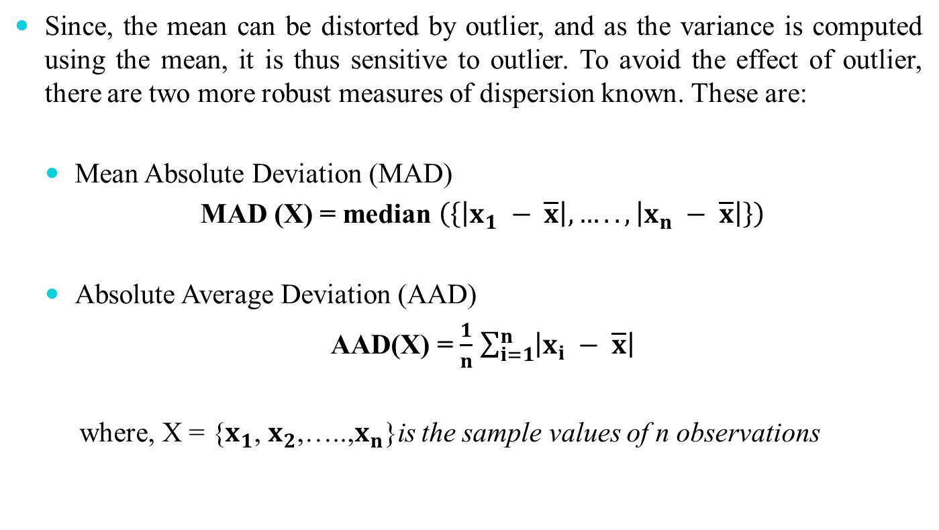
Mean Absolute Deviation (MAD)
Since, the mean can be distorted by outlier, and as the variance is computed using the mean, it is thus sensitive to outlier. To avoid the effect of outlier, there are two more robust measures of dispersion known. These are:
Mean Absolute Deviation (MAD)
MAD (X) = median $\left(\left\{\left|x_{1} − \overline{x}\right|,…..,\left|x_{n} − \overline{x}\right|\right\}\right)$
Absolute Average Deviation (AAD)
AAD(X) = $\frac{1}{n}$ $\sum_{i=1}^{n}{\left|x_{i} − \overline{x}\right|}$
where, X = {$x_{1}$, $x_{2}$,…..,$x_{n}$}is the sample values of n observations

Slide 67
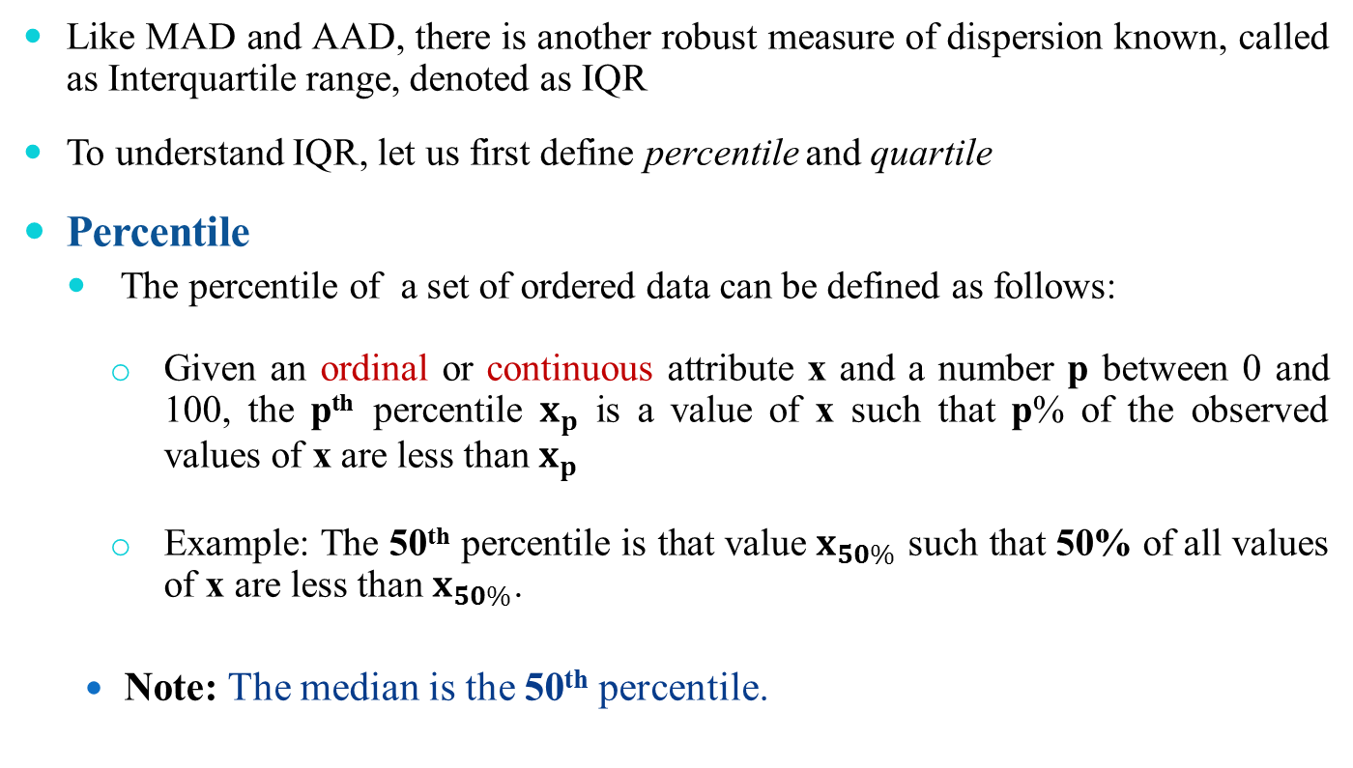
Interquartile Range
Like MAD and AAD, there is another robust measure of dispersion known, called as Interquartile range, denoted as IQR
To understand IQR, let us first define percentile and quartile
Percentile
The percentile of a set of ordered data can be defined as follows:
Given an ordinal or continuous attribute x and a number p between 0 and 100, the p^{th} percentile $x_{p}$ is a value of x such that p% of the observed values of x are less than $x_{p}$
Example: The 50th percentile is that value $x_{50\%}$ such that 50% of all values of x are less than $x_{50\%}$.
Note: The median is the 50th percentile.

Slide 68
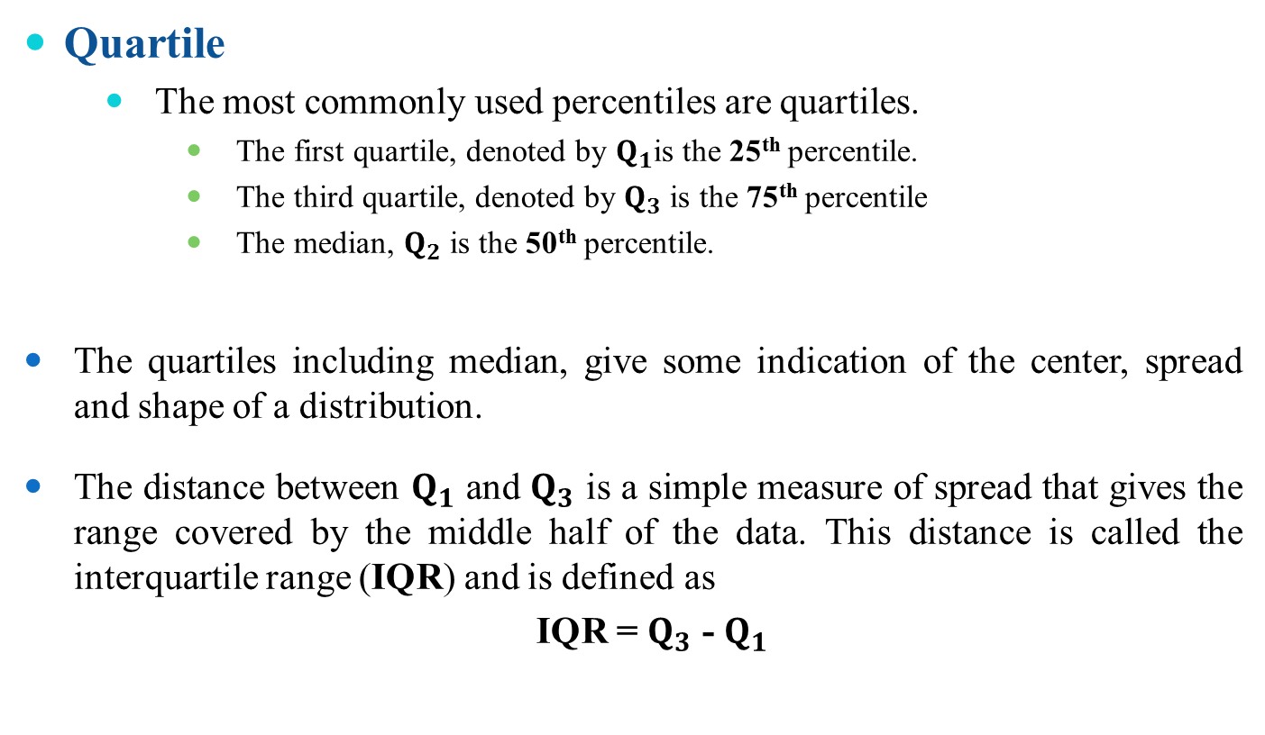
Interquartile Range
Quartile
The most commonly used percentiles are quartiles.
The first quartile, denoted by $Q_{1}$is the 25th percentile.
The third quartile, denoted by $Q_{3}$ is the 75th percentile
The median, $Q_{2}$ is the 50th percentile.
The quartiles including median, give some indication of the center, spread and shape of a distribution.
The distance between $Q_{1}$ and $Q_{3}$ is a simple measure of spread that gives the range covered by the middle half of the data. This distance is called the interquartile range (IQR) and is defined as
IQR = $Q_{3}$ - $Q_{1}$

Slide 69

Application of IQR
Outlier detection using five-number summary
A common rule of the thumb for identifying suspected outliers is to single out values falling at least 1.5 × IQR above $Q_{3}$ and below $Q_{1}$.
In other words, extreme observations occurring within 1.5 × IQR of the quartiles

Slide 70
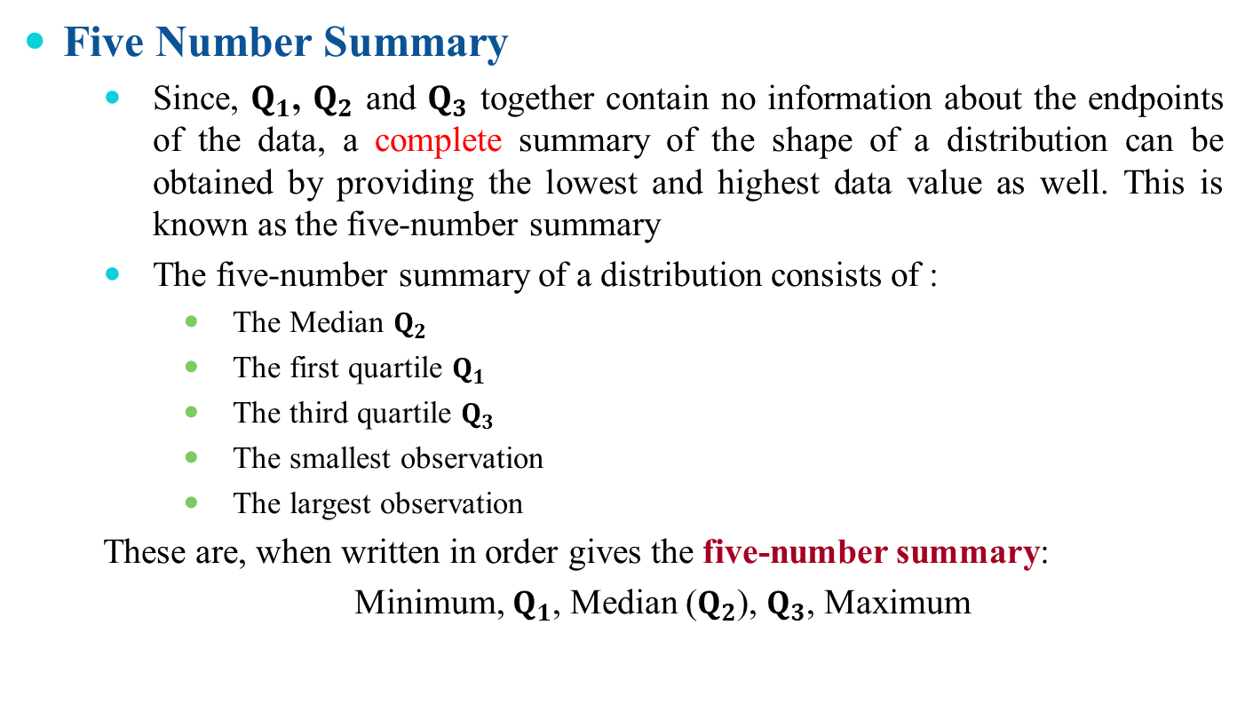
Application of IQR
Five Number Summary
Since, $Q_{1}$, $Q_{2}$ and $Q_{3}$ together contain no information about the endpoints of the data, a complete summary of the shape of a distribution can be obtained by providing the lowest and highest data value as well. This is known as the five-number summary
The five-number summary of a distribution consists of :
The Median $Q_{2}$
The first quartile $Q_{1}$
The third quartile $Q_{3}$
The smallest observation
The largest observation
These are, when written in order gives the five-number summary:
Minimum, $Q_{1}$, Median ($Q_{2}$), $Q_{3}$, Maximum

Slide 71
Box plot
Graphical view of Five number summary

Slide 72
Reference
The detail material related to this lecture can be found in
Probability and Statistics for Enginneers and Scientists (8th Ed.) by Ronald E. Walpol, Sharon L. Myers, Keying Ye (Pearson), 2013 .

Slide 73
Any question?
You may post your question(s) at the “Discussions” in the course Web page!

Slide 74
Questions of the day…
Which of the following central tendency measurements allows distributive, algebraic and holistic measure?
mean
median
Mode
Which measure may be faster than other? Why?
Give three situations where AM, GM and HM are the right measure of central tendency?

Slide 75
Questions of the day…
Given a sample of data, how to decide whether it is
Symmetric?
Skew-symmetric (positive or negative)?
Uniformly increasing (or decreasing)?
In-variate?
How the box-plots will look for the following types of samples?
a) Symmetric b) Positively skew-symmetric
c) Negatively skew-symmetric d) in-variate

Slide 76
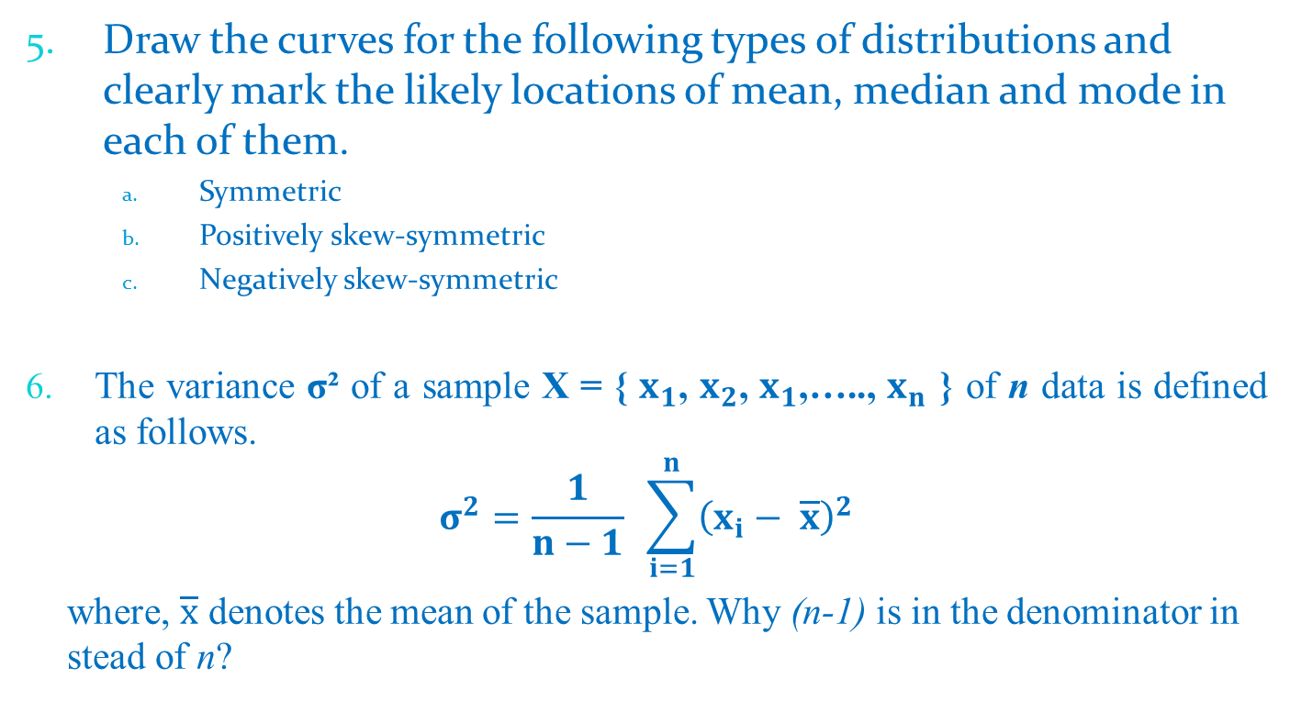
Questions of the day…
Draw the curves for the following types of distributions and clearly mark the likely locations of mean, median and mode in each of them.
Symmetric
Positively skew-symmetric
Negatively skew-symmetric
The variance σ² of a sample X = { $x_{1}$, $x_{2}$, $x_{1}$,….., $x_{n}$ } of n data is defined as follows.
$$σ^{2}=\frac{1}{n−1} \sum_{i=1}^{n}{{\left(x_{i}− \overline{x}\right)}^{2}}$$
where, $\overline{x}$ denotes the mean of the sample. Why (n-1) is in the denominator in stead of n?

Slide 77
Questions of the day…
What are the degree of freedoms in each of the following cases.
A sample with a single data
A sample with n data
A sample of tabular data with n rows and m columns

